Slide 1

User Analysis & Task Analysis
Chapter 2

Slide 2
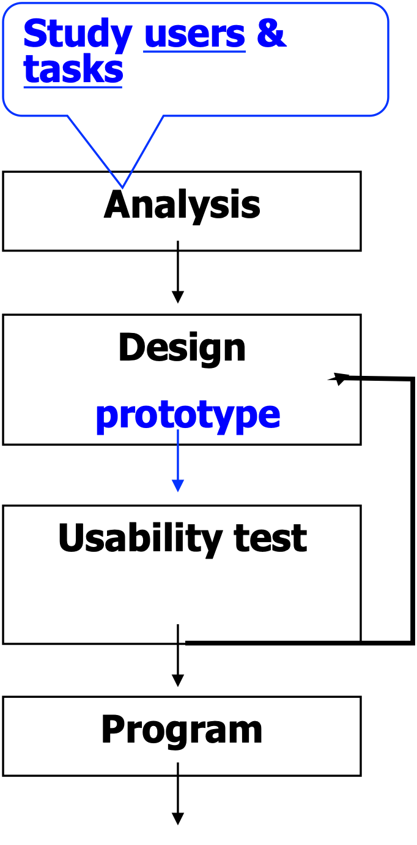
User Analysis
To design an effective system, it is necessary to know the answers to the following 3 questions
Who are the users?
What are the tasks?
What is the environment in which the system will operate?

Slide 3
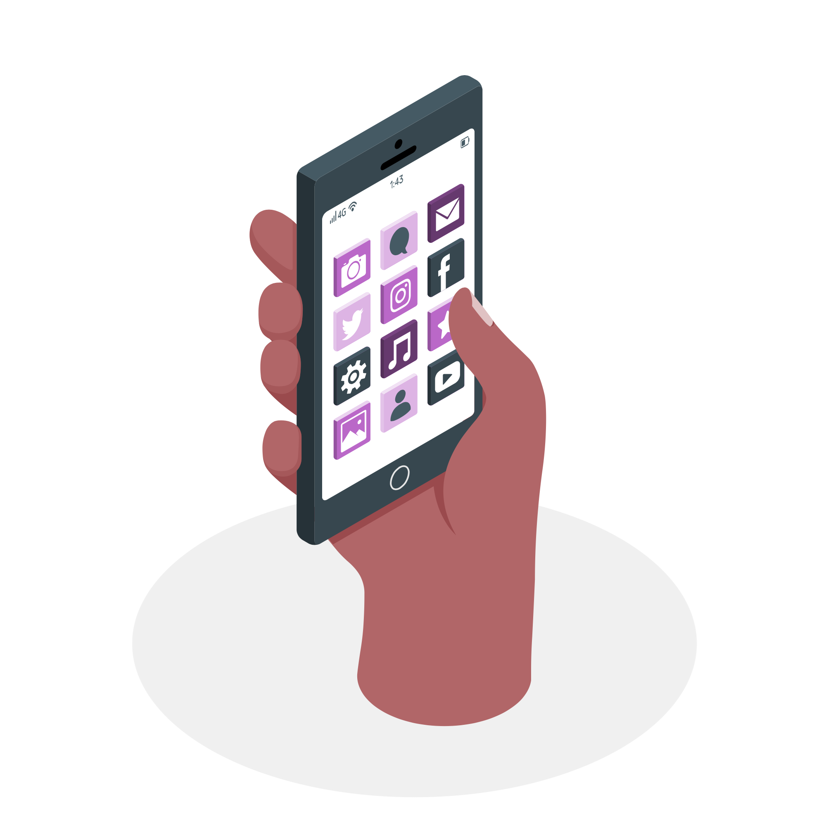
Example:
Task: reading news on apps
User: Elderly vs teenager
Environment: Inside MRT/LRT, day/night time

Slide 4
User Types
Novice users: Users who attempt to use a system for the first time
Novice users are generally unfamiliar with the system but may well understand the goals to be accomplished
E.g.1: a new lecturer who wants to upload notes, tut Q and assignment Q to Google Classroom.
E.g.2: a person who attempts to buy a train ticket online for the first time

Slide 5
Knowledgeable intermittent users:
Irregular users of many systems
They have a stable knowledge of the task, but have difficulty in remembering details of system operations because of not using systems regularly. ( e.g. Using e-filling for income tax once a year)
Expert/Frequent users:
Users who are very familiar with the systems and tasks
They are well versed in computer terminologies and syntax

Slide 6
Design for Novice Users
1)All initiatives should come from the computer
The designer of a system should consider the novice user to be like a shy visitor who needs prompting.
Examples:
Date : _________ (use dd/mm/yy)
Name: __________ (last, first, middle)
Tel : __________ (area code - phone no)
For novice users, system should be designed to tell them what to do and they simply respond to instructions

Slide 7
2) Each required input should be brief
Designers should NOT assume that novice users are proficient keyboard operators.
3)No special training should be necessary
All info needed to operate the system should be provided by the system
The system should make it clear what has to be done
4)All system messages should be clear and unambiguous

Slide 8
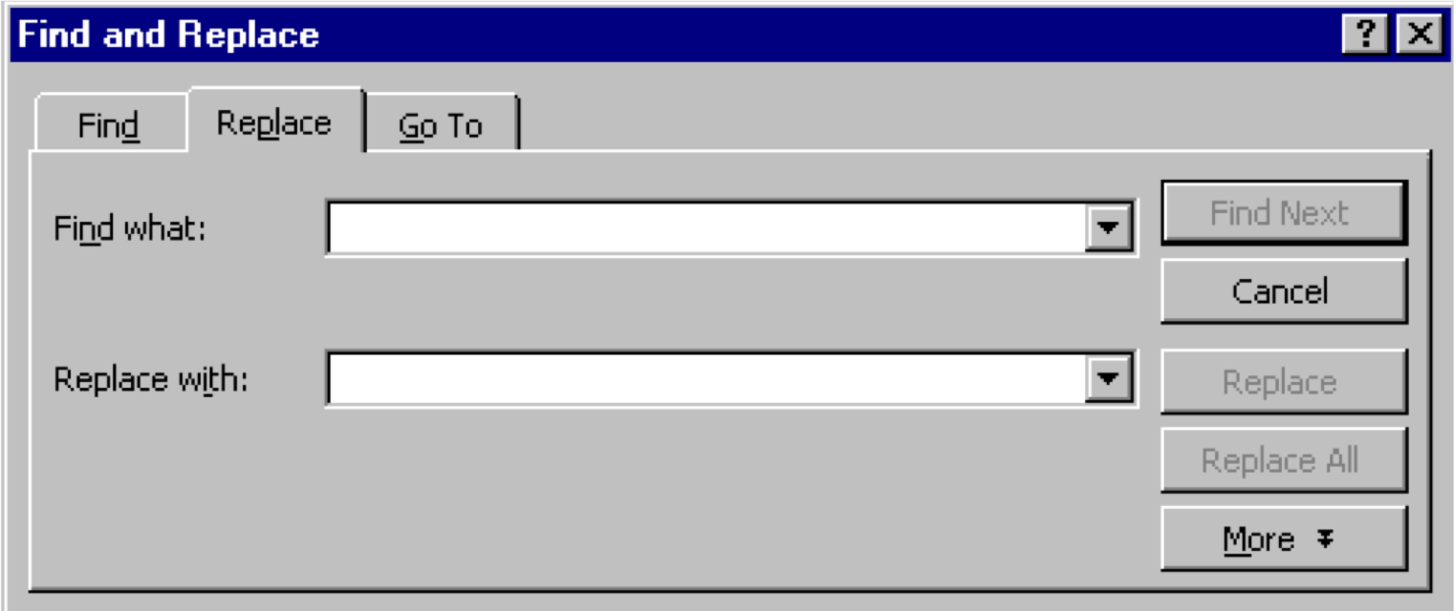
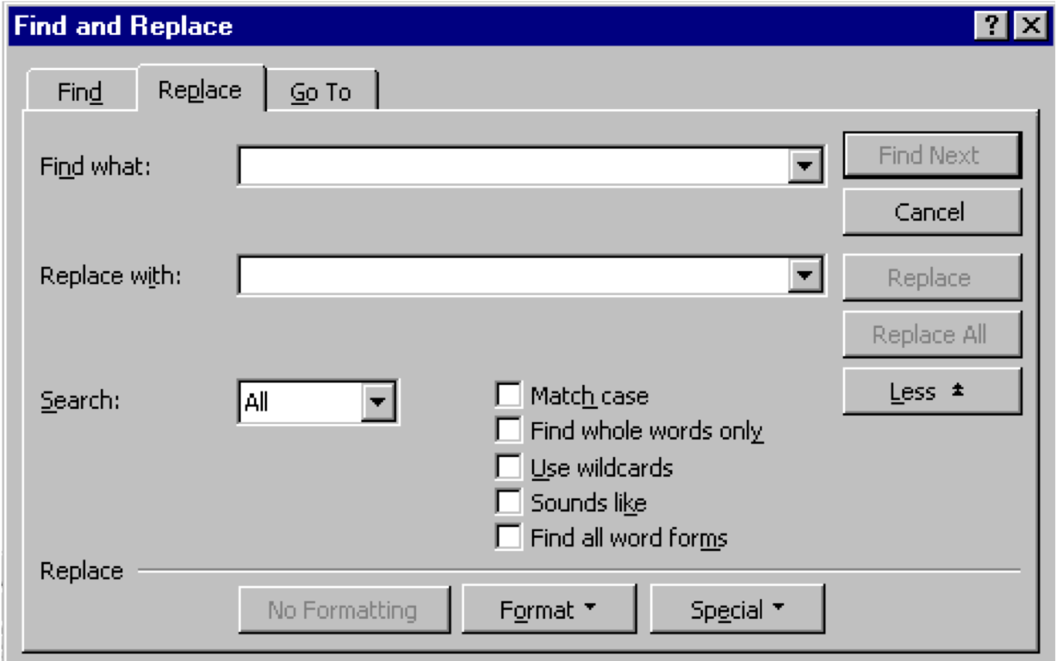
5)User decisions should be made from a small set of options
Novice users need to make choices from a small number of options available since it makes them feel that the system is limited in size and it avoids feelings of being overwhelmed by the enormity of the system
6) There should be sufficient feedback help.

Slide 9
Design for Knowledgeable Intermittent Users
1) System should be consistent
2) System should provide good help facilities and good documentation

Slide 10
Design For Expert Users
1) Feedback should be brief
2) Command sequences should be offered in abbreviated and meningful form, e.g. copy command in Unix: cp
3) Where possible, keyboard shortcuts should be provided

Slide 11
Understanding Users :Requirements
Type of requirements:
Functional Requirements
What the system should do.E.g. save Historical data
Non-functional Requirements
Usability goals, response time...
Non-functional requirements describe how the system works, while functional requirements describe what the system should do

Slide 12

How to Understand
Users?

Slide 13
Gathering Data for Requirements
1) Interviews
Users of a product should be the main focus of the design effort. They are the people who are personally utilizing the product to accomplish a goal (not their managers or support team).
Interviewing both current and potential users illuminates the effect that experience with the current version of a product may have on how the user behaves and thinks about things.

Slide 14
Information we are interested in learning from users includes:
The context of how the product (or analogous system, if no current product exists) fits into their lives or workflow: when, why, and how the product is or will be used
Domain knowledge from a user perspective: What do users need to know to do their jobs?
Goals and motivations for using their product
Mental model: how users think about their jobs and activities, as well as what expectations users have about the product
Problems and frustrations with current products (or an analogous system if no current product exists)

Slide 15
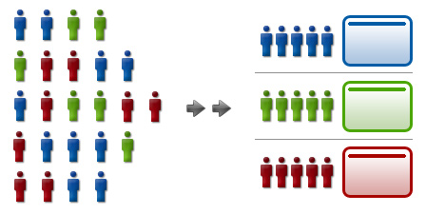
2) Focus groups
is representative users, usually chosen to match previously identified demographic segments of the target market, are gathered together in a room and asked a structured set of questions and provided a structured set of choices.

Slide 16
3) Card Sorting
is a technique to understand how users organize information and concepts.
performed by asking users to sort a deck of cards, each containing a piece of functionality or information related to the product or Web site.
to uncover one aspect of a user’s mental model.

Slide 17
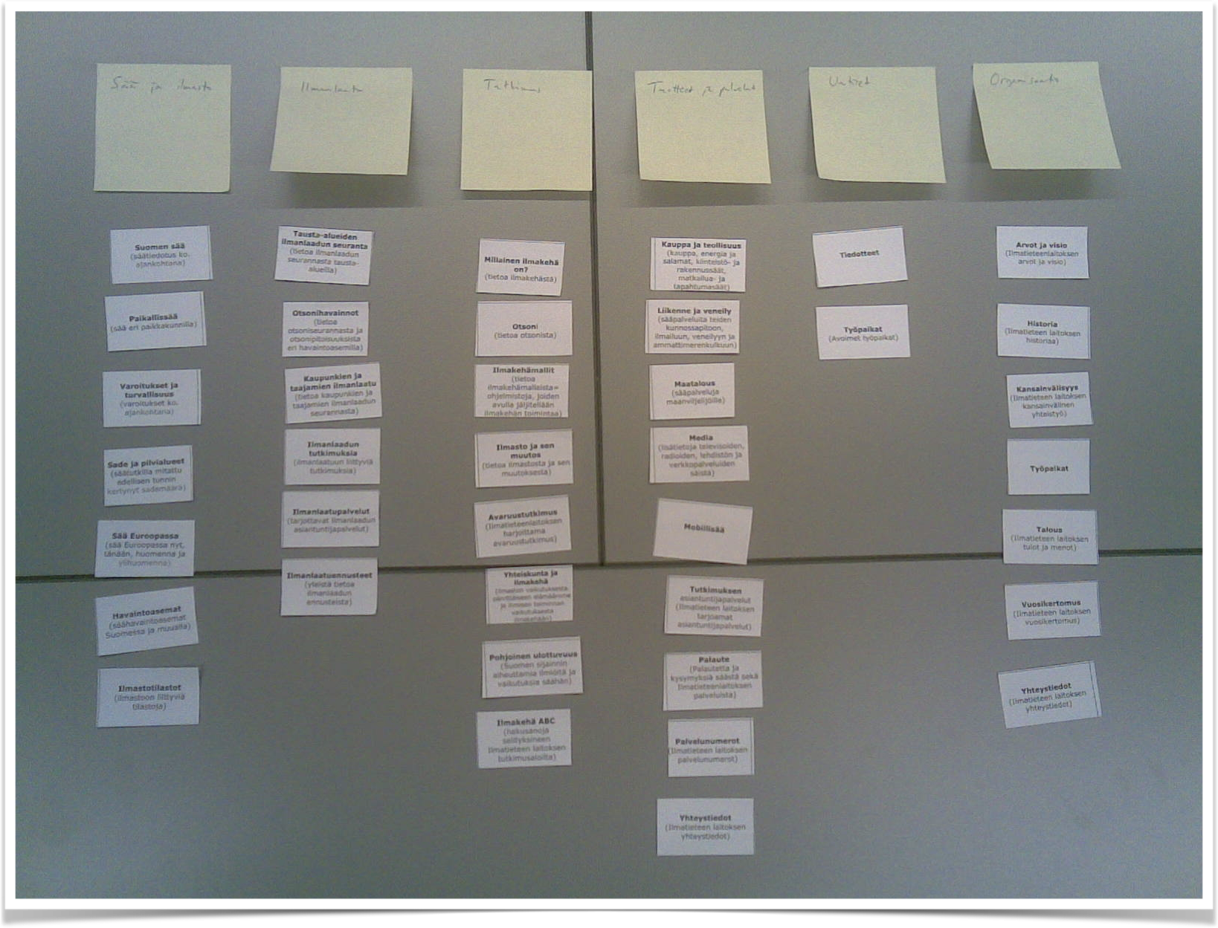
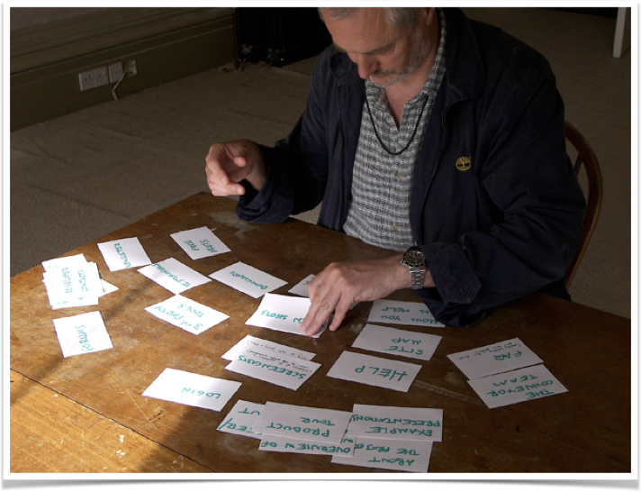

Slide 18
3) Questionnaires
Advantage:
a usability questionnaire gives you feedback from the point of view of the user.
If the questionnaire is reliable, and you have used it according to the instructions, then this feedback is a trustworthy sample of what you get from your whole user population.
disadvantage :
Need time and affort in setting realiable questionaire.
*reliablity is the ability of the questionnaire to give the same results when filled out by like-minded people in similar circumstances.

Slide 19
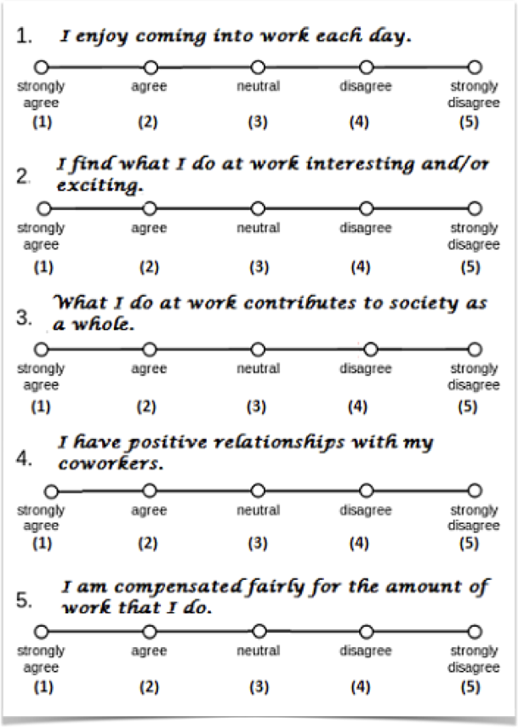

Check boxes
Liker scale

Slide 20
4) Observation
Most people are incapable of accurately assessing their own behaviours especially when they are removed from the context of their activities.
Observational methods involve an investigator viewing users as they work in a field study, and taking notes on the activity that takes place.
Direct : investigator is actually present during the task.
Indirect: the task is viewed by some other ways such as through use of a video recorder.
It is also useful for studying currently executed tasks and processes.
It should be noted that observation can be obtrusive and subjects may alter their behaviour due to the presence of an observer.

Slide 21



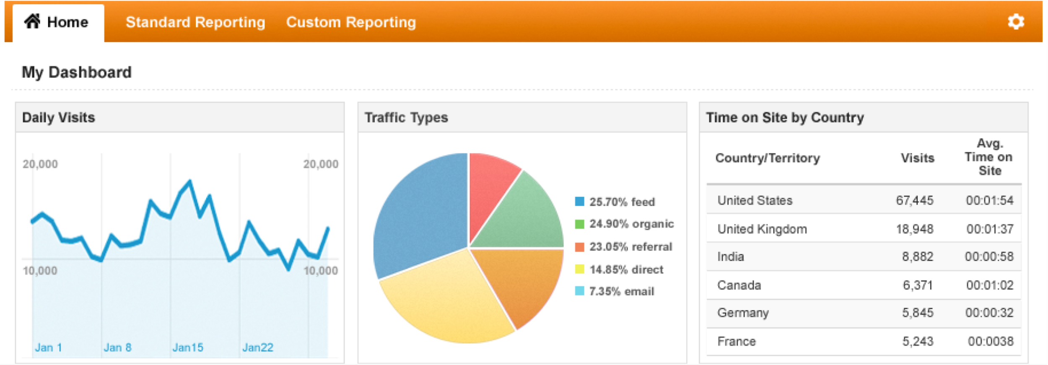
Diary
web traffic analytics

Slide 22
After Data Gathering,
What’s Next?

Slide 23
User needs analysis
Users can be classified according to their
Demographics (e.g. age, gender)
Occupational experience (e.g. job title, years of experience)
Educational level
Experience, etc.

Slide 24

Why model the user?
They are powerful tools for representing complex structures and relationships for the purpose of better understanding, discussing, or visualizing them.
Without models, we are left to make sense of unstructured, raw data, without the benefit of any organizing principle.
Personas are models for users that represent their relationships with physical world, environment and product.

Slide 25
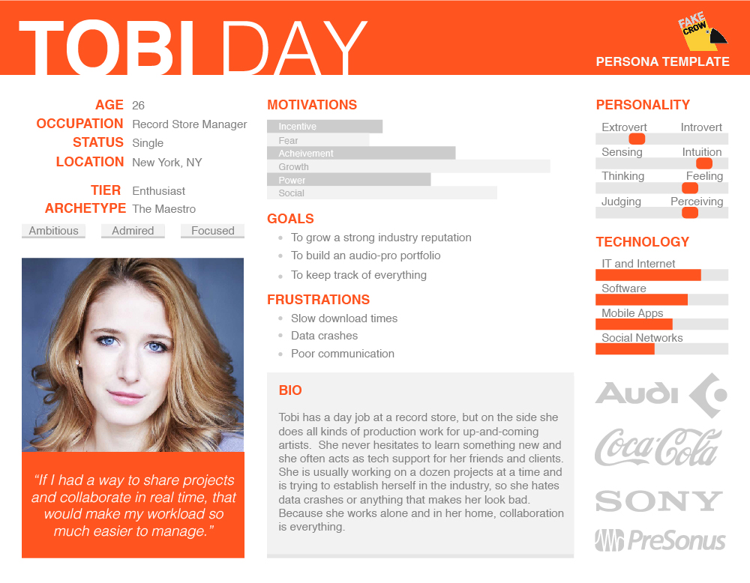
http://fakecrow.com/free-persona-template/

Slide 26
Persona
Personas are user models that are represented as specific, individual human beings. They are not actual people but are synthesized directly from observations of real people.
Personas must be based on real-world observation.

Slide 27
Data that can support and supplement the creation of personas include:
Interviews
Market research data such as focus groups and surveys
Market-segmentation models
Data gathered from literature reviews and previous studies

Slide 28
Persona are NOT | Persona are
What people tell you about themselves | what you observe
About customer likes or dislikes | about what frustrate or satisfy a customer
A job description or a documentary about a person | About skills, attitude, motivation, environment and goals
job description | presenting behaviour patterns

Slide 29
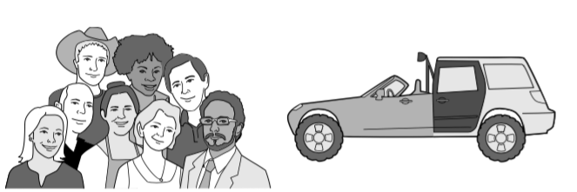
If you try to design a car that pleases every possible driver, you end up with a car with every possible feature, but that pleases nobody.

Slide 30
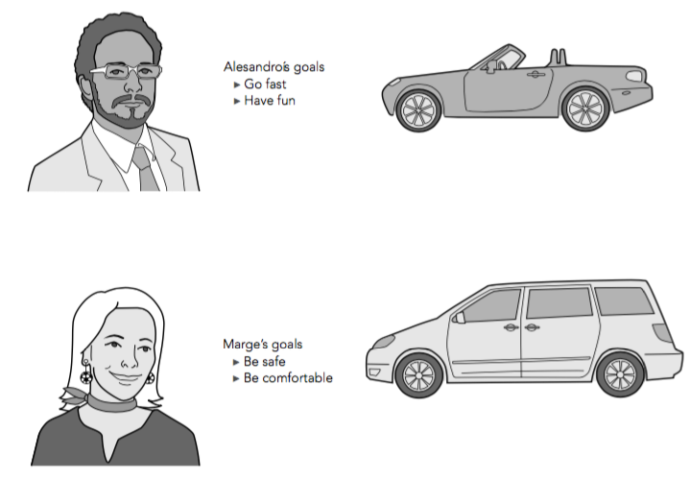
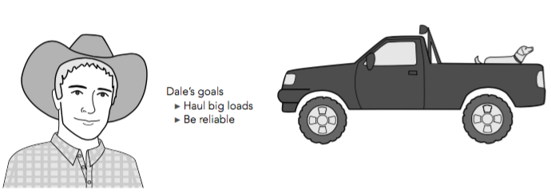

Slide 31
Types of Personas
Marketing personas:
focus on demographic information, buying motivations and concerns, shopping or buying preferences, marketing message, media habits.
Marketing personas are good for determining what types of customers will be receptive to certain products or messages, or for evaluating potential ROI of a product.

Slide 32
Proto—personas:
used when there is no money or time to create true research—based personas – they are based on secondary research. ( mostly based on assumptions)
Design personas:
focus on user goals, current behaviour, and pain points as opposed to their buying or media preferences and behaviours.
They are based on field research and real people.

Slide 33
Creating Persona
Bring persona to life by adding following minimum details:
First and last name
Picture
Demographics (age, location, gender, job title, etc.
etc..

Slide 34

Identify behaviour variables .
Focus on the following variable types:
Activities – What user does; frequency and volume
Attitudes – How user thinks about product domain and technology
Motivations/Goals – Why user is engaged in product domain
Skills – User’s capabilities related to product domain and technology
Pain points/ frustrations

Slide 35
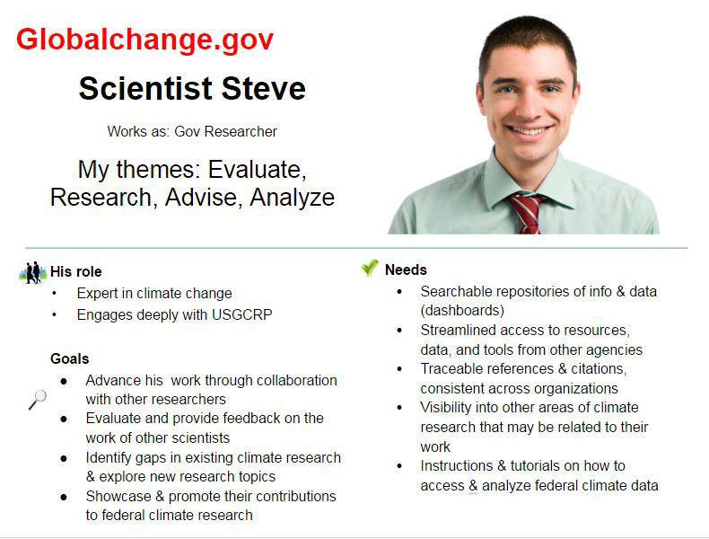
Persona examples

Slide 36
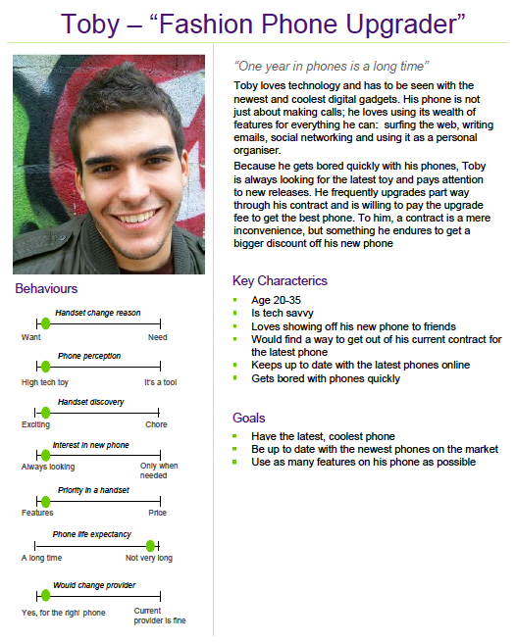

Slide 37
After User Analysis,
What’s Next?

Slide 38
After persona…..
Uses personas to create stories that point to design.
Developing stories or scenarios as a means of imagining user interactions.
using those scenarios to define requirements.
Using these requirements in turn to design the product.

Slide 39
Scenario
use scenario to represent the task.
focuses on describing how users accomplish tasks. It consists of an environmental setting and includes agents or actors (persona).
A persona provides a tangible representation of the user to act as a believable agent in the setting of a scenario
Scenario content and context are derived from information gathered during the Research phase and analyzed during the Modelling phase.
A scenario is an informal narrative description of a specific interaction, usually with a real-world setting.

Slide 40
Scenario Example 1
“The Thomson family enjoy outdoor activity holidays and want to go sailing. While out shopping they call at the travel agents in their local town to start exploring the possibilities ... The travel organizer is located in a quiet corner of the agents’ office, where there are comfortable seats and play things for young children. They all gather around the organizer and enter their initial set of requirements—a sailing holiday for four novices. The stand-alone console is designed so that all members of the family can interact easily and comfortably with it. The system’s initial suggestion is that they should consider a flotilla holiday, where several novice crews go sailing together and provide mutual support for first-time sailors…” (Preece, Rogers & Sharp, 2011)

Slide 41
Scenario Example 2
Brian would like to see the new film “Moments of Significance” and wants to invite Alison, but he knows she doesn’t like “arty” films. He decides to take a look at it to see if she would like it and so connects to one of the movie sharing networks. He uses his work machine as it has a higher bandwidth connection, but feels a bit guilty. He knows he will be getting an illegal copy of the film, but decides it is OK as he is intending to go to the cinema to watch it. After it downloads to his machine he takes out his new personal movie player. He presses the menu button and on the small LCD screen he scrolls using the arrow keys to bluetooth connect and presses the select button. On his computer the movie download program now has an icon showing that it has recognised a compatible device and he drags the icon of the film over the icon for the player. . . .”

Slide 42
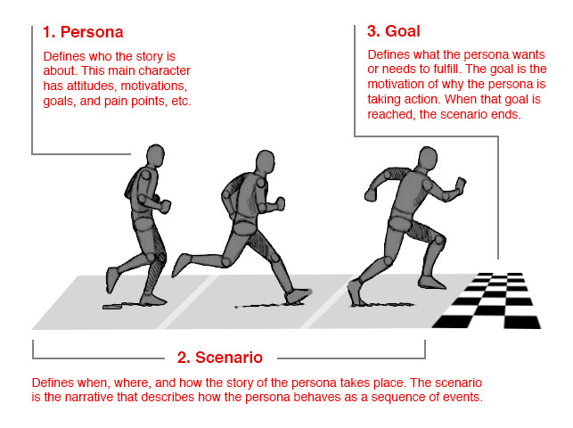

Slide 43
After Scenario,
What’s Next?

Slide 44
Environment Analysis
scenarios describe the broad context in which usage patterns and include environmental considerations.
should focus on high-level actions from the user’s perspective. It is important to map out the big picture first so that we can systematically identify user requirements. Only then will we be able to design appropriate interactions and interfaces.

Slide 45
Environment analysis address questions such as the following:
In what setting (environment) will the product be used? (indoor,outdoor,public, private,noisy,quiet…)
Will it be used for extended amounts of time?
Is the persona frequently interrupted?
Are there multiple users on a single workstation or device?
With what other products will it be used?

Slide 46
After Environment Analysis,
What’s Next?

Slide 47
Task Analysis
Task analysis is used mainly to investigate an existing situation
Focus on important activities (tasks)
What are people trying to achieve?
How are they going about it?
most popular modelling technique is Hierarchical Task Analysis (HTA)
focus on physical and observable actions.

Slide 48
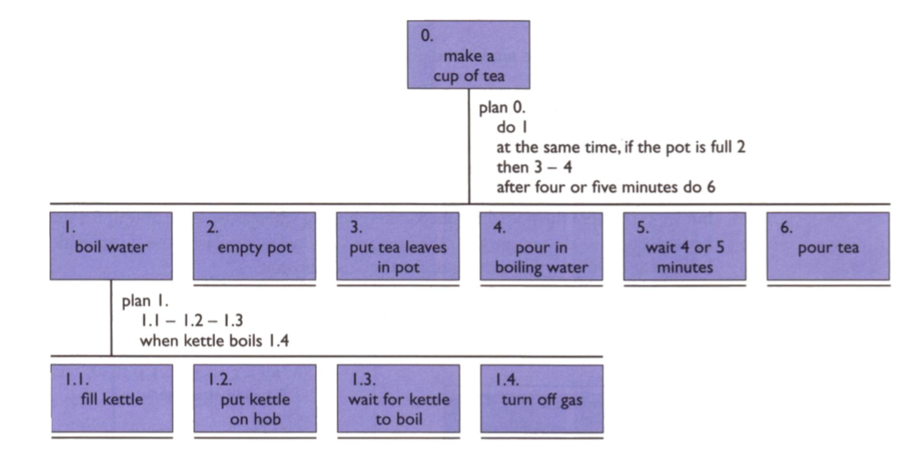

Slide 49
Hierarchical Task Analysis
Involves breaking a task down into subtasks, then sub-sub-tasks and so on.
HTA focuses on physical and observable actions, and includes looking at actions not related to software or an interaction device
Start with a user goal which is examined and the main tasks for achieving it are identified

Slide 50
1. Identify the task to be analysed.
2. Break this down into subtasks. These subtasks should be specified in terms of objectives and, between them, should cover the whole area of interest.
3. Draw the subtasks as a layered diagram ensuring that it is complete.
4. Decide upon the level of detail into which to decompose.
5. Continue the decomposition process, ensuring that the decompositions and numbering are consistent.

Slide 51
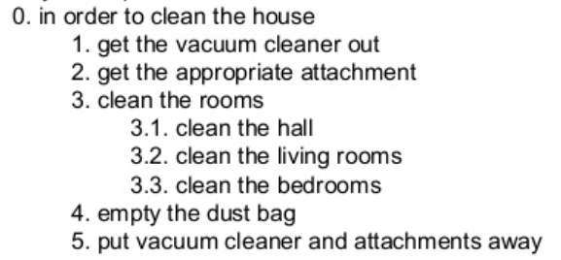
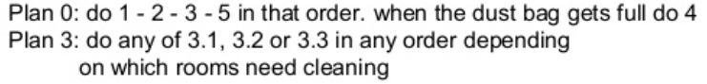
HTA in list form:

Slide 52
Why we need HTA?

Slide 53
Uses of Task Analysis in HCI
To understand the way user perform their CURRENT JOB with an existing system (manual or computerised system)
By understanding what the user has been doing, a new system can then be arranged in a way that is compatible with the user's accustomed behaviours i.e. to make the new system compatible with what the user already does
Advantages:
Skill learned from the old system can be transferred to the new system
User need not alter his/her approach significantly when using the new system
In addition, task analysis can also be used for producing documentations & training materials

Slide 54
Any other analysis tools?

Slide 55
Other Analysis Tools
Empathy mapping
Customer journey mapping
Experience mapping
Service blueprinting
Job-To-Be-Done
etc…

Slide 56
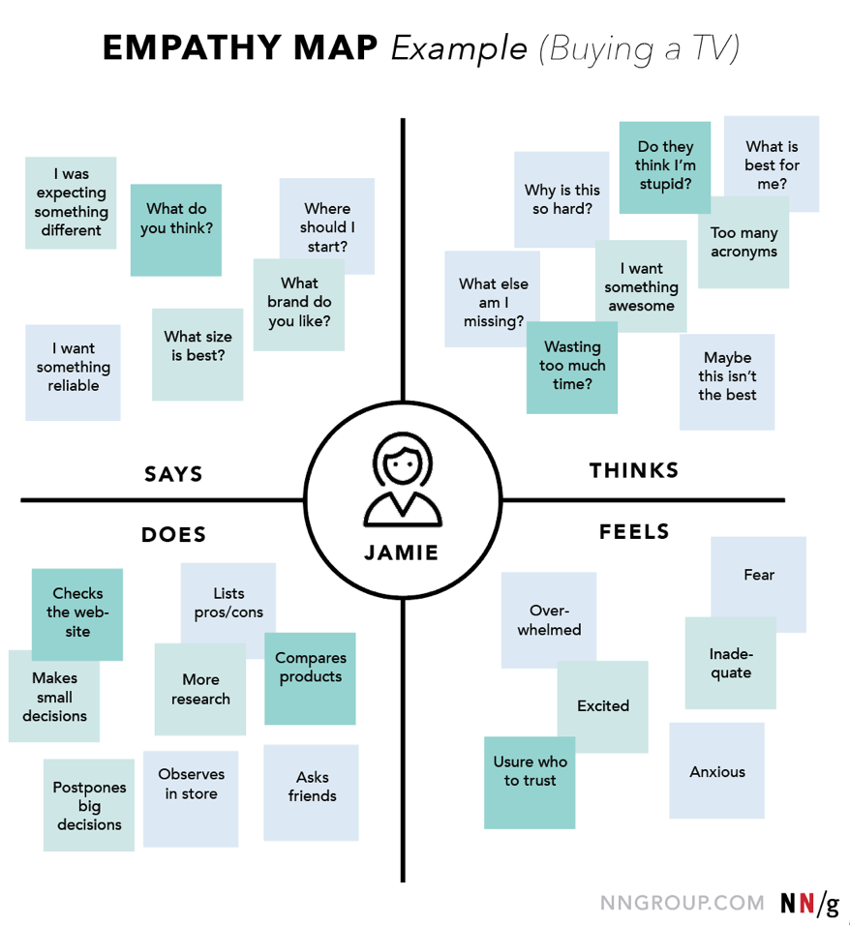
https://www.nngroup.com/articles/ux-mapping-cheat-sheet/

Slide 57
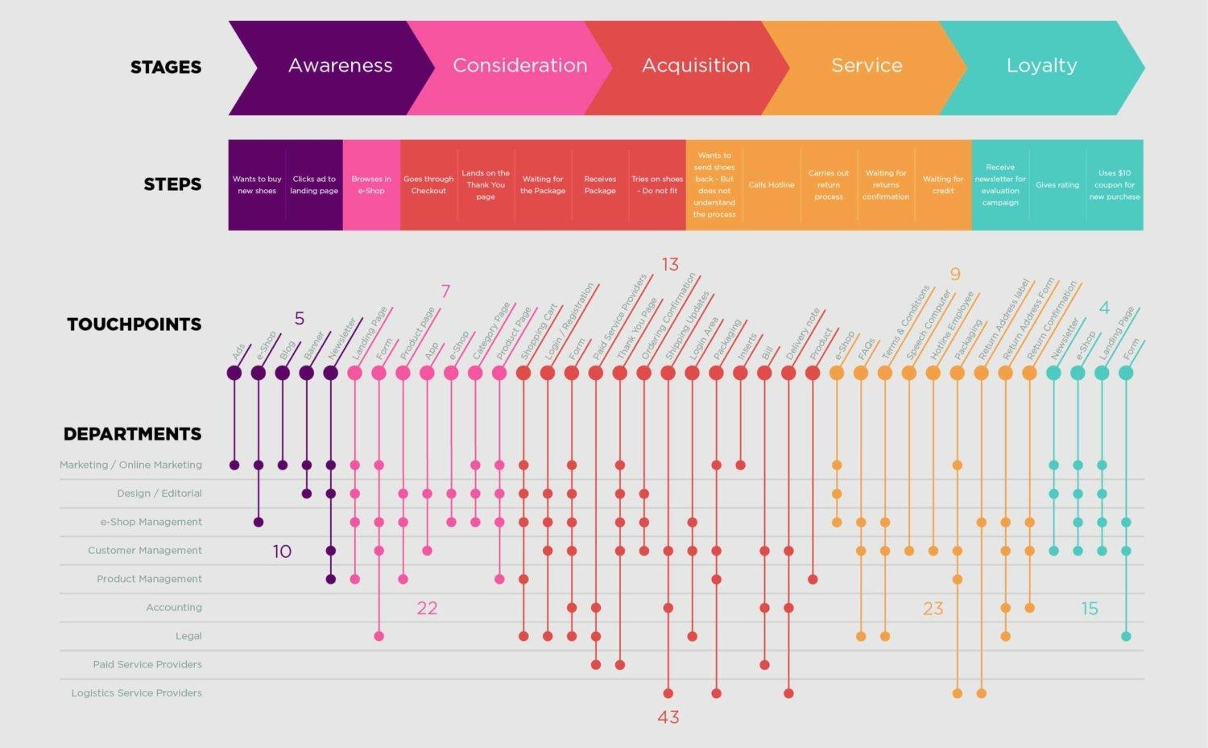
Customer journey mapping
https://www.brightvessel.com/customer-journey-map-2018/

Slide 58

See more eye catching examples on Pintrest

Slide 59
Thank you

